Slide 1


Bringing Your Data to Life in the ArcGIS API for JavaScript: 3D Objects
Russell Roberts & Kristian Ekenes
Notes:
Esri Corporate Template-Dark v3.3
16:9 version – January 21, 2016
For more templates, sample files, and icons, see https://compass.esri.com/resources/presentations/Pages/Main.aspx
To add footer text in Windows
On the Home tab, under Insert, click Text, and then click Header and Footer.
Click the Slide tab, select the Footer check box, and then type the footer text that you want.
Click either Apply or Apply to All.
To add footer text on a Mac
On the View menu, select Header and Footer.
Select the Footer check box and then type the footer text that you want.
Click either Apply or Apply to All.
If footers don't appear on the slides
If footers don't appear on title slides, in the Header and Footer dialog box make sure the Don't show on title slide check box is not selected.
If the footers are missing from other slides, the placeholders for these items might have been removed from specific slide layouts or the slide master.

Slide 2
What are we using in this Demo Theater
ArcGIS Pro 1.4.1
ArcGIS Online
Hosted Feature Layers & Hosted Scene Layers
ArcGIS API for JavaScript 4.3

Slide 3
What are 3DObject Scene Layers?
The are a 3D optimized layer that help display large amounts of data
Used to display mutlipatch features
Can be textured or untextured
Published from Scene Layer Packages or Feature Layers in AGOL
Can be in WGS84 (Global Scenes) or any Projected Coordinate System (Local Scenes)

Slide 4
Demo: Preparing Your Data
Russ Roberts
Notes:
I show the mutlipatch data in ArcGIS Pro
Say it can be shared as a FL from Pro or ArcMap, Or in this case I uploaded a zipped GDB
Then show a completed FL
Then go through the process of publishing the SL and talk global vs. local
Finally show a completed SL that will be in the SV.
Go back to the FL and configure the popup, reload the Web Scene and have the new popup displayed

Slide 5
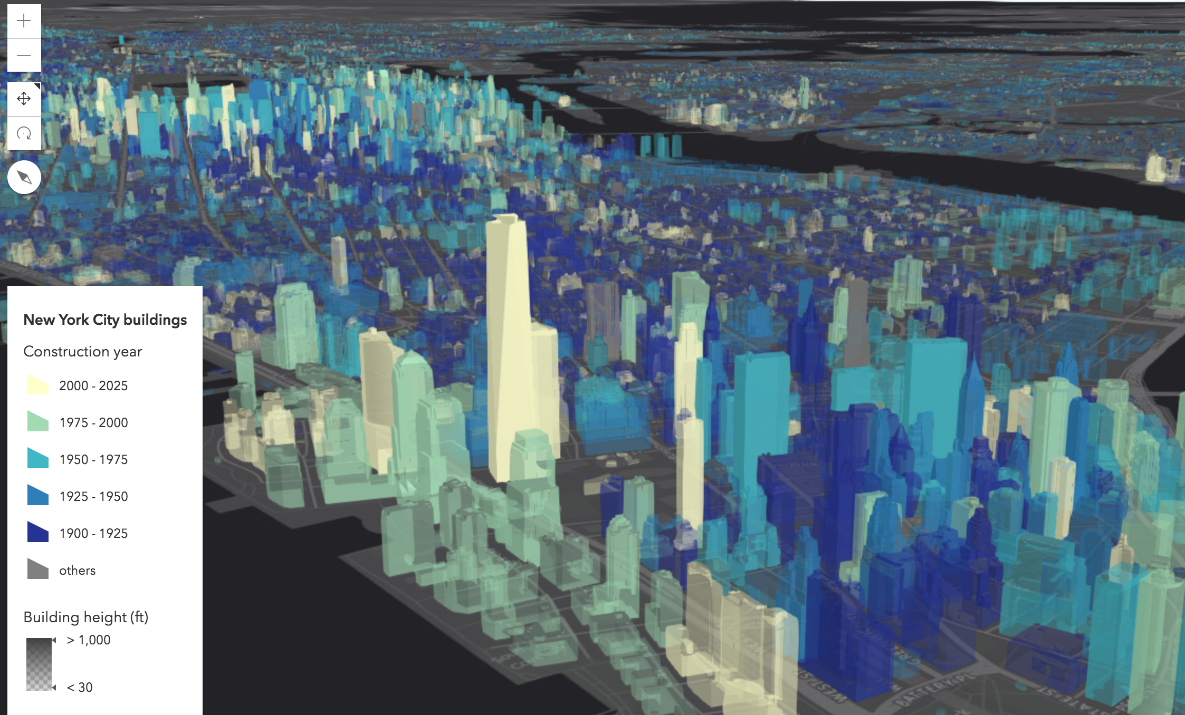
Demo: Using 3DObject Scene Layers in the JS API
Kristian Ekenes

